Slide 1
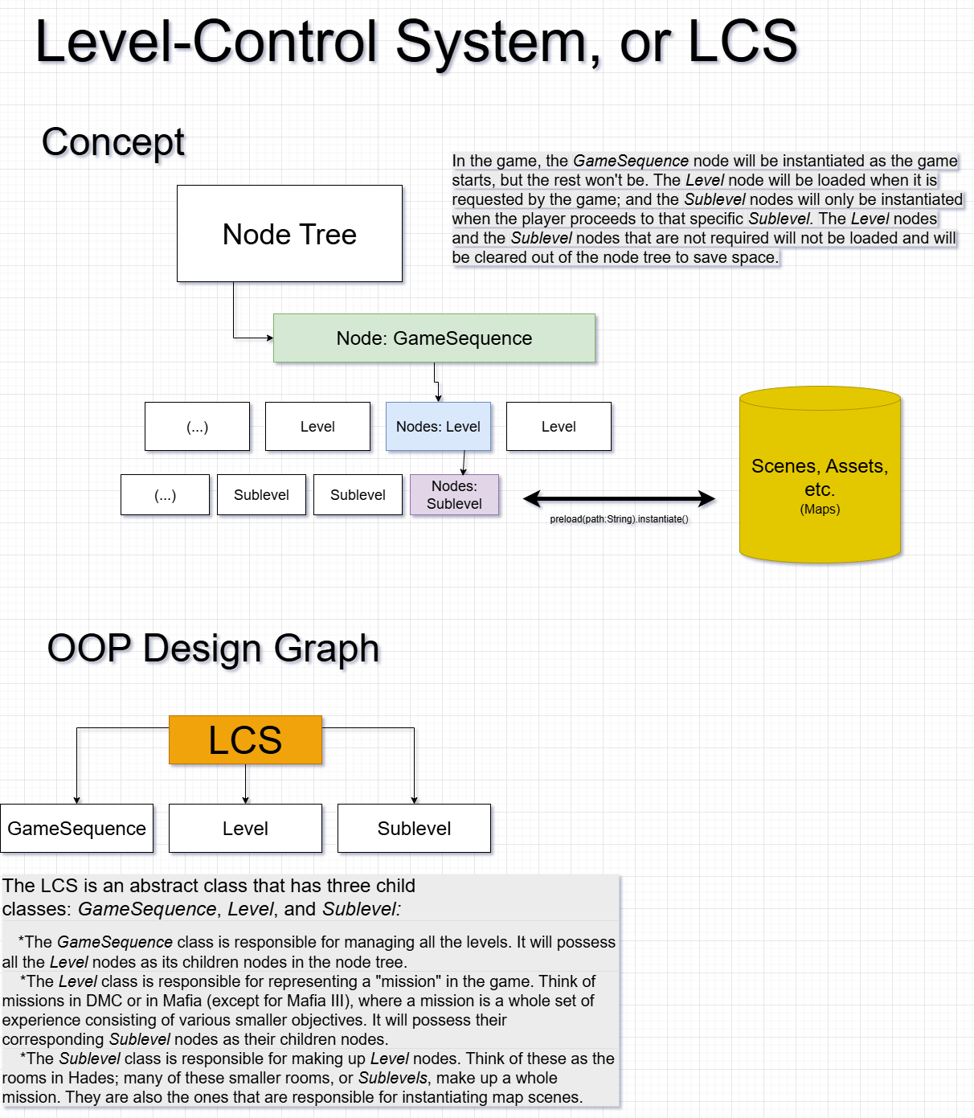
LEVEL-CONTROL SYSTEM,
LCS
A system for representing,
loading, and managing levels
Yes please read the picture on the left I know its small
I will explain this on Sunday if this is not clear

Slide 2
The way LCS manages level sequence
GameSequence holds a list of all the Levels, and each Level holds a list of its own Sublevels. Each Sublevel holds a list of the map scenes it will contain.
LCS does NOT hold a sequence of how Levels and Sublevels are arranged.
Rather, each Level and Sublevel will have a list of which Levels/Sublevels they can proceed to.
Within the game, for example, if player is going to enter a new Sublevel from a previous Sublevel through a portal, that portal should call on its parenting Sublevel to ask its Level node to load and instantiate the requested Sublevel into the node tree, and then enter that Sublevel.
This allows the Sublevels to be freely arranged instead of staying linear: players can return to previous Sublevels, have different Sublevels to go to in the same Sublevel, etc.

Slide 3
How does LCS load itself?
1: Game begins, GameSequence node is instantiated.
gets a list of all the Levels (by name) at res://LCS/GameSequence.lcssave
2: When a Level is requested, GameSequence uses its list to instantiate the corresponding Level node by first loading the data from res://LCS/Levels/<levelname>.lvsave and then instantiating the Level node as its child node. Any previous Level nodes will also be removed.
3: The Level node is instantiated with a list of its Sublevels (by name). When a Sublevel is requested, it will first load Sublevel data from res://LCS/Sublevels/<sublevelname>.sblsave and then instantiating that Sublevel node. The other Sublevel nodes will not be removed.
4: The Sublevel node is thus instantiated. It will hold a list of all the map scenes it needs to have, and will load the requested map scene. If player goes from one map to another within this Sublevel, the Sublevel node will have corresponding method for doing that.

